Slide 1
ER Accessibility per Neighborhood in Toronto
Edgar Hoyos, Electronics Engineer
Document presented for IBM Applied Capstone Project

Slide 2
Introduction
The accessibility to Emergency Rooms is an important aspect for people wellbeing and is a concern for city administrators to guarantee Access to all the residents of the cities.
Data
Toronto Geojson
Toronto neighborhoods profile
Foursquare API Data
Open Street Map Data

Slide 3
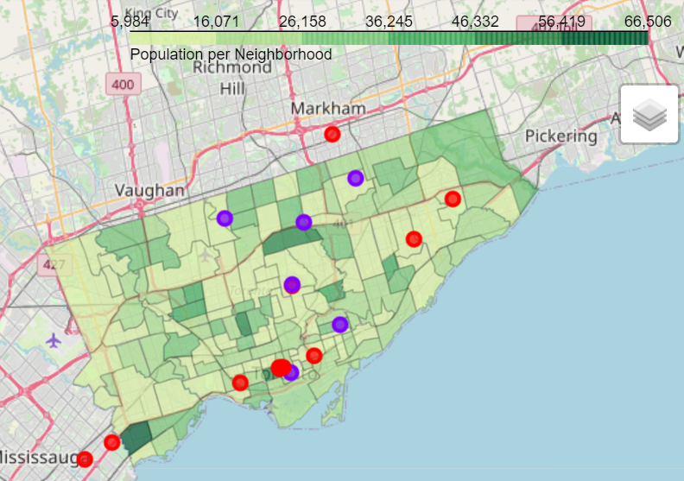
Toronto population per neighborhood and ER locations

Slide 4
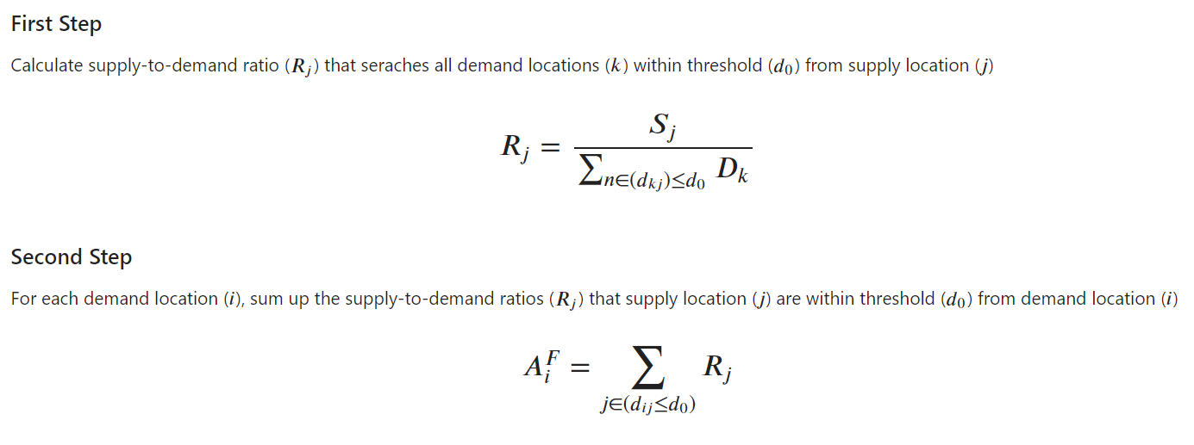
Two Step Floating Catchment Area (2FSCA)

Slide 5
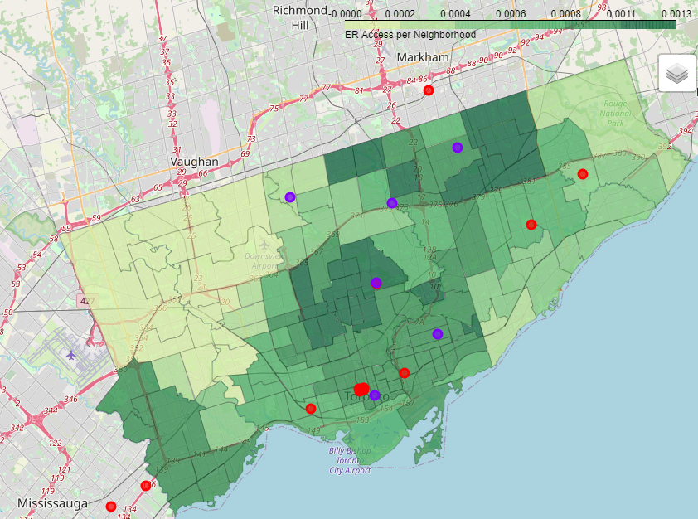
Toronto ER accessibility score per neighborhood using 2FSCA with radius 10km

Slide 6
Conclusions
Based on the information described in the previous section the administration of Toronto might plan to grow bigger its health system to improve accessibility to healthcare services in the northwest part of the city.
The 2FSCA method seems to deliver information accordingly to the expected output but special care might have to be taken into account for the results obtained at the borders of the area of analysis or restrict the search for venues inside the selected area.

